Slide 1
Logical Database Design and
Relational Model

Slide 2
Objectives
Definition of terms
List five properties of relations
State two properties of candidate keys
Transform E-R and EER diagrams to relations

Slide 3
Relation
Definition: A relation is a named, two-dimensional table of data
Table consists of rows (records) and columns (attribute or field)
Requirements for a table to qualify as a relation:
  It must have a unique name
  Every attribute value must be atomic (not multivalued, not composite)
  Every row must be unique (can’t have two rows with exactly the same values for all their fields)
  Attributes (columns) in tables must have unique names
  The order of the columns must be irrelevant
  The order of the rows must be irrelevant
NOTE: all relations are in 1st Normal form

Slide 4
Correspondence with E-R Model
Relations (tables) correspond with entity types and with many-to-many relationship types
Rows correspond with entity instances and with many-to-many relationship instances
Columns correspond with attributes
NOTE: The word relation (in relational database) is NOT the same as the word relationship (in E-R model)

Slide 5

Key Fields
Keys are special fields that serve two main purposes:
  Primary keys are unique identifiers of the relation in question. Examples include employee numbers, social security numbers, etc. This is how we can guarantee that all rows are unique
  Foreign keys are identifiers that enable a dependent relation (on the many side of a relationship) to refer to its parent relation (on the one side of the relationship)
Keys can be simple (a single field) or composite (more than one field)
Keys usually are used as indexes to speed up the response to user queries (More on this in Ch. 6)

Slide 6
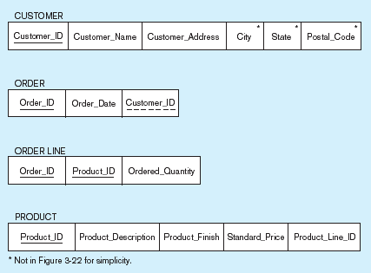
Figure 5-3 Schema for four relations (Pine Valley Furniture Company)
Primary Key
Foreign Key (implements 1:N relationship between customer and order)
Combined, these are a composite primary key (uniquely identifies the order line)…individually they are foreign keys (implement M:N relationship between order and product)

Slide 7
Integrity Constraints
Domain Constraints
  Allowable values for an attribute. See Table 5-1 (pg 193)
Entity Integrity
  No primary key attribute may be null. All primary key fields MUST have data
Action Assertions
  Business rules. Recall from Ch. 4

Slide 8
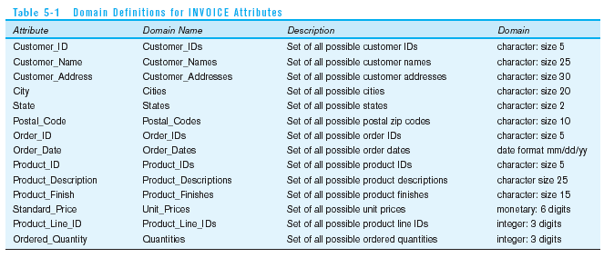
Domain definitions enforce domain integrity constraints

Slide 9
Integrity Constraints
Referential Integrity–rule states that any foreign key value (on the relation of the many side) MUST match a primary key value in the relation of the one side. (Or the foreign key can be null)
  For example: Delete Rules
    Restrict–don’t allow delete of “parent” side if related rows exist in “dependent” side
    Cascade–automatically delete “dependent” side rows that correspond with the “parent” side row to be deleted
    Set-to-Null–set the foreign key in the dependent side to null if deleting from the parent side → not allowed for weak entities

Slide 10
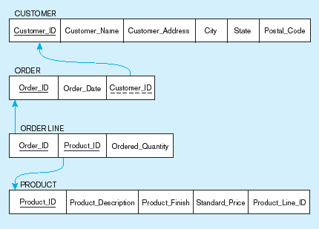
Figure 5-5
Referential integrity constraints (Pine Valley Furniture)
Referential integrity constraints are drawn via arrows from dependent to parent table

Slide 11
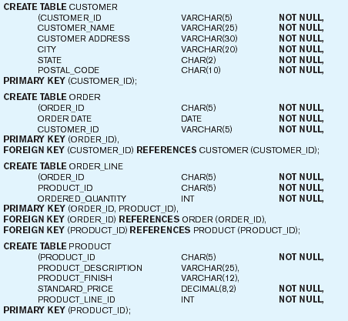
Figure 5-6 SQL table definitions
Referential integrity constraints are implemented with foreign key to primary key references

Slide 12
Transforming EER Diagrams into Relations
Mapping Regular Entities to Relations
  Simple attributes: E-R attributes map directly onto the relation
  Composite attributes: Use only their simple, component attributes
  Multivalued Attribute–Becomes a separate relation with a foreign key taken from the superior entity

Slide 13


Figure 5-8 Mapping a regular entity
(a) CUSTOMER entity type with simple attributes
(b) CUSTOMER relation

Slide 14


Figure 5-9 Mapping a composite attribute
(a) CUSTOMER entity type with composite attribute
(b) CUSTOMER relation with address detail

Slide 15

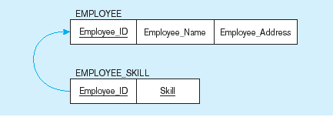
Figure 5-10 Mapping an entity with a multivalued attribute
(a)
Multivalued attribute becomes a separate relation with foreign key
(b)
One–to–many relationship between original entity and new relation

Slide 16
Transforming EER Diagrams into Relations (cont.)
Mapping Weak Entities
  Becomes a separate relation with a foreign key taken from the superior entity
  Primary key composed of:
    Partial identifier of weak entity
    Primary key of identifying relation (strong entity)

Slide 17
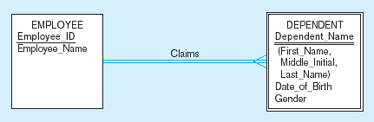
Figure 5-11 Example of mapping a weak entity
a) Weak entity DEPENDENT

Slide 18
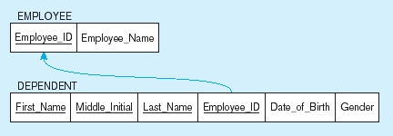
Figure 5-11 Example of mapping a weak entity (cont.)
b) Relations resulting from weak entity
NOTE: the domain constraint for the foreign key should NOT allow null value if DEPENDENT is a weak entity
Foreign key
Composite primary key

Slide 19
Transforming EER Diagrams into Relations (cont.)
Mapping Binary Relationships
  One-to-Many–Primary key on the one side becomes a foreign key on the many side
  Many-to-Many–Create a new relation with the primary keys of the two entities as its primary key
  One-to-One–Primary key on the mandatory side becomes a foreign key on the optional side

Slide 20
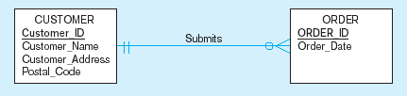
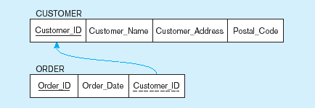
Figure 5-12 Example of mapping a 1:M relationship
a) Relationship between customers and orders
Note the mandatory one
b) Mapping the relationship
Again, no null value in the foreign key…this is because of the mandatory minimum cardinality
Foreign key

Slide 21
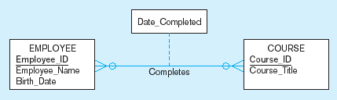
Figure 5-13 Example of mapping an M:N relationship
a) Completes relationship (M:N)
The Completes relationship will need to become a separate relation

Slide 22
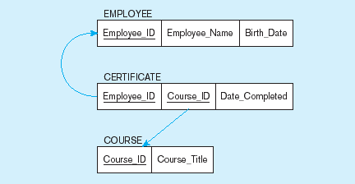
Figure 5-13 Example of mapping an M:N relationship (cont.)
b) Three resulting relations
Composite primary key
Foreign key
New intersection relation
Foreign key

Slide 23
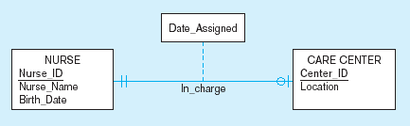
Figure 5-14 Example of mapping a binary 1:1 relationship
a) In_charge relationship (1:1)
Often in 1:1 relationships, one direction is optional.

Slide 24
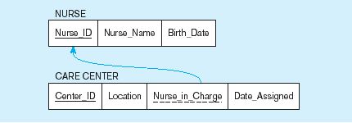
Figure 5-14 Example of mapping a binary 1:1 relationship (cont.)
b) Resulting relations
Foreign key goes in the relation on the optional side,
Matching the primary key on the mandatory side

